Slide 1
Data Science Project – Bitcoin Value
What is bitcoin
Bitcoin is a form of digital currency, created and held electronically.
No one controls it. Bitcoins aren’t printed, like dollars or euros – they’re produced by people, and increasingly businesses, running computers all around the world, using software that solves mathematical problems.
bitcoin is created digitally, by a community of people that anyone can join. Bitcoins are ‘mined’, using computing power in a distributed network.
21 million bitcoins can ever be created by miners. However, these coins can be divided into smaller parts

Slide 2
Data Science Project – Bitcoin Value
Project Approach
Like all financial instruments and commodities, the price of bitcoin also varies with demand and supply
Since the supply is said to be constant at 21 million in the next 100 years and supply depends on rate of mining, it is interesting to determine factors that affect demand
Approach is to predict the price of bitcoin by analyzing trends of bitcoin value against a data points that may drive bitcoin transactions, an indicator of demand thereby driving its price

Slide 3
Data Science Project – Bitcoin Value
Data set
Currency:
Currency exchange rates are indicators of a countries economy, inflation, import-export etc.
Source: https://www.quandl.com/data/CURRFX/USDEUR-Currency-Exchange-Rates-USD-vs-EUR
Gold:
Gold has traditionally been an indicator of economic health
https://www.quandl.com/data/LBMA/GOLD-Gold-Price-London-Fixing
Oil:
Oil prices impact the transportation, energy and manufacturing sectors thereby creating a major impact on the economy
https://www.quandl.com/data/DOE/RWTC-WTI-Crude-Oil-Spot-Price-Cushing-OK-FOB?utm_medium=graph&utm_source=quandl
Stock Market:
Stock market index is an indicator of market performance
https://www.quandl.com/data/BCB/UDJIAD1-Dow-Jones-Industrial-Average

Slide 4
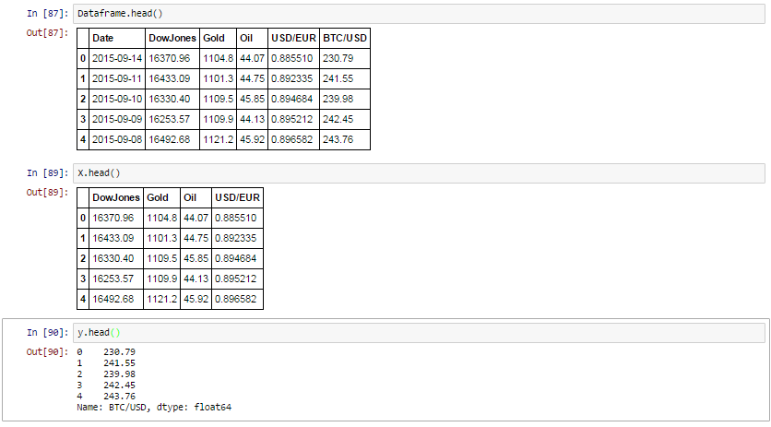
Data Science Project – Bitcoin Value
Data set snapshot

Slide 5
Data Science Project – Bitcoin Value
Links to project material
Project gitHub link
https://github.com/Ameyadeolalkar/Data-science-course-projects-and-homeworks/tree/master/Project
Data files
https://github.com/Ameyadeolalkar/Data-science-course-projects-and-homeworks/tree/master/Project/csv_files
Code
https://github.com/Ameyadeolalkar/Data-science-course-projects-and-homeworks/tree/master/Project/Code

